Slide 1
Clean Architecture
Implementing in .NET
Ian Cooper
@ICooper

Slide 2
Who are you?
Software Developer for more than 20 years
Worked mainly for ISVs
Reuters, SunGard, Misys, Huddle
Worked for a couple of MIS departments
DTI, Beazley
Microsoft MVP for C#
Interested in architecture and design
Interested in Agile methodologies and practices
No smart guys
Just the guys in this room

Slide 3
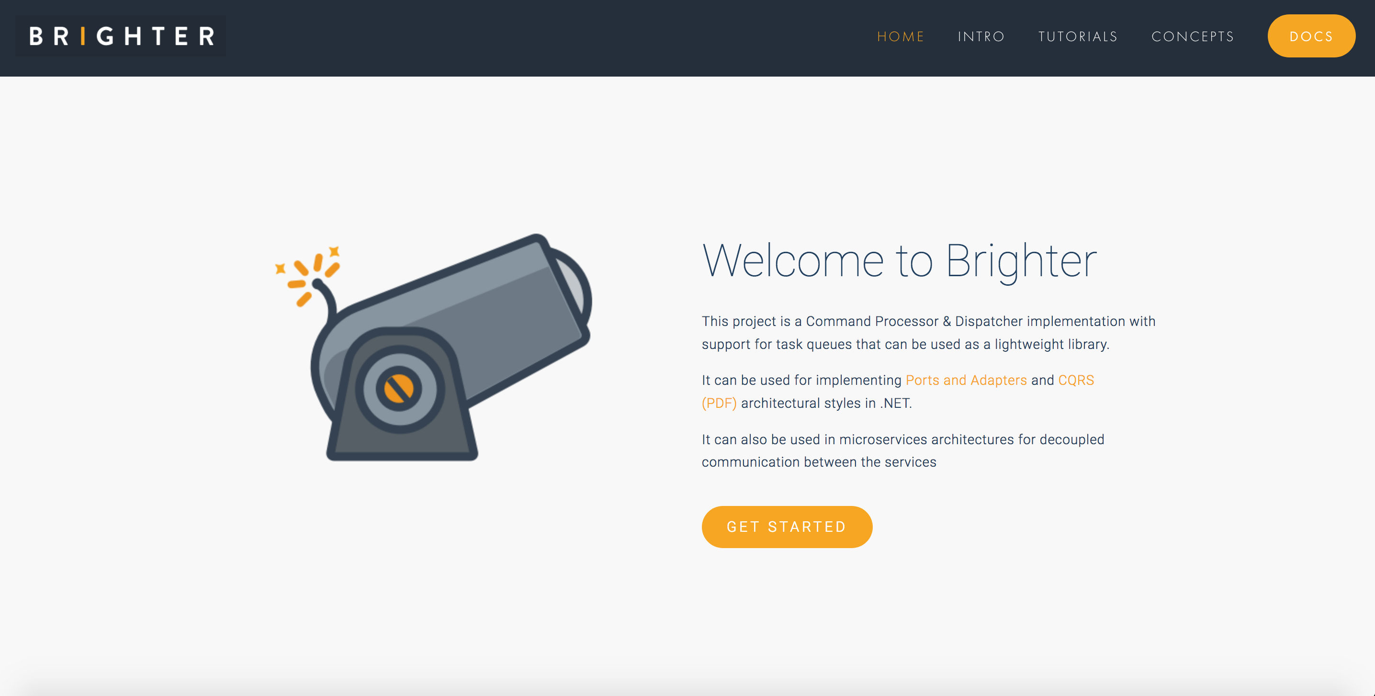

Slide 4
Agenda
On Loose Coupling and High Cohesion
On Layering
On Domains
On The Use Case Controller
On Clean Architecture
On Implementing

Slide 5
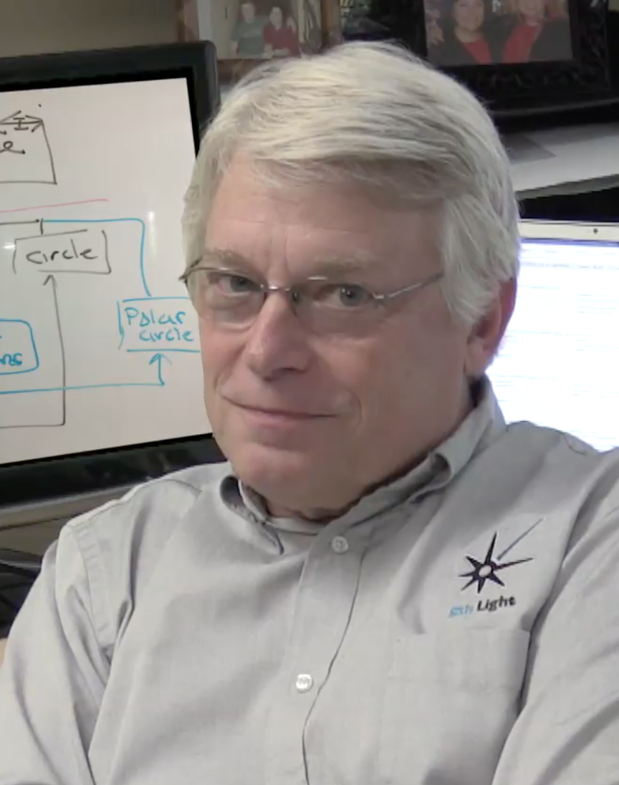




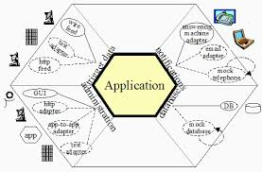
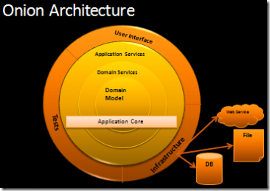
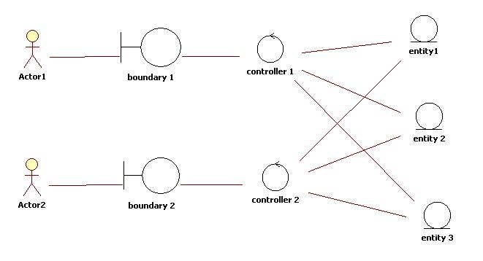
Robert Martin
Jeffrey Palermo
Ivar Jacobson
Alistair Cockburn

Slide 6
On Loose Coupling and High Cohesion

Slide 7
A key responsibility for architects is partitioning the system.
A goal in partitioning the system is to reduce the coupling in the system and improve the cohesion so as to improve its modifiability.
A clean architecture can be thought of as one one where the partitioning leads to low coupling and high cohesion.

Slide 8
Coupling is the property that one module is forced to change because another does
There are various forms of coupling. We may have a direct code dependency in that a type in Module A depends on a type in module B, but we might also have knowledge in Module A that mirrors knowledge in Module B
Two modules can be said to be loosely coupled if changes to the implementation details of one do not impact the implementation of the other.
Loose coupling is desirable, because it reduces the cost of change
The Duplicated Code smell is a common cause of coupling
Notes:
Code Smells = Fowler in Refactoring
Note that Duplicated Code is a problem where it causes coupling. Duplicated code that does not cause coupling i.e. a sort algorithm used in two places is not of concern

Slide 9
Cohesion is the property that a module is subject to the same forces of change
A module that has low-cohesion has many reasons to change. The impact of this change is that code that shares the same module must be checked because of changes that it did not care about.
Divergent Change is a code smell from low cohesion

Slide 10
On Layering

Slide 11
A
UI
Domain
C
D
Infrastructure
Notes:
We depend downward with a layered infrastructure to prevent cycles of dependency between modules.
When thinking of a system in terms of layers, you imagine the principal subsystems in the software arranged in some form of layer cake, where each layer rests on a lower layer. In this scheme the higher layer uses various services defined by the lower layer, but the lower layer is unaware of the higher layer. Furthermore, each layer usually hides its lower layers from the layers above, so layer 4 uses the services of layer 3, which uses the services of layer 2, but layer 4 is unaware of layer 2. Fowler, Martin. Patterns of Enterprise Application Architecture (Addison-Wesley Signature Series (Fowler)) (p. 17).
Presentation logic is about how to handle the interaction between the user and the software. This can be as simple as a command-line or text-based menu system, but these days it’s more likely to be a rich-client graphics UI or an HTML-based browser UI. (In this book I use rich client to mean a Windows/Swing/fat-client UI, as opposed to an HTML browser.) The primary responsibilities of the presentation layer are to display information to the user and to interpret commands from the user into actions upon the domain and data source.
Data source logic is about communicating with other systems that carry out tasks on behalf of the application. These can be transaction monitors, other applications, messaging systems, and so forth. For most enterprise applications the biggest piece of data source logic is a database that is primarily responsible for storing persistent data.
The remaining piece is the domain logic, also referred to as business logic. This is the work that this application needs to do for the domain you’re working with. It involves calculations based on inputs and stored data, validation of any data that comes in from the presentation, and figuring out exactly what data source logic to dispatch, depending on commands received from the presentation.

Slide 12
We can reason about a layer as a coherent whole, without worrying about the implementation of other layers
You can substitute layers with alternative implementations
You can defer decisions about layer implementations
You can minimize dependencies between layers

Slide 13
A
UI
B
Service
Domain
Entity
C
D
Infrastructure
Notes:
A common approach in handling domain logic is to split the domain layer in two.
A Service Layer is placed over an underlying Entity Model.
Usually you only get this with a Domain Model (since a domain layer that uses only Transaction Script isn’t complex enough to warrant a separate layer. The presentation logic interacts with the domain purely through the Service Layer, which acts as an API for the application.

Slide 14
We can distinguish two types of ‘business logic’
Domain logic, having to do purely with the domain, such as calculating an insurance premium, or figuring out the shortest path to ship a package.
Application logic, having to do with application responsibilities, often referred to as workflow logic

Slide 15
The Service Layer represent application logic. It is most commonly associated with co-ordination and control logic for the domain, and calls to the Infrastructure layer to ‘load’ the domain.
As well as providing an API, the Service Layer is also the place where we can put transaction control and security.
Notes:
As well as providing a clear API, the Service Layer (133) is also a good spot to place such things as transaction control and security. This gives you a simple model of taking each method in the Service Layer (133) and describing its transactional and security characteristics. A separate properties file is a common choice for this, but .NET’s attributes provide a nice way of doing it directly in the code.
When you see a Service Layer (133), a key decision is how much behavior to put in it. The minimal case is to make the Service Layer (133) a facade so that all of the real behavior is in underlying objects and all the Service Layer (133) does is forward calls on the facade to lower-level objects. In that case the Service Layer (133) provides an API that’s easier to use because it’s typically oriented around use cases. It also makes a convenient point for adding transactional wrappers and security checks. At the other extreme, most business logic is placed in Transaction Scripts (110) inside the Service Layer (133). The underlying domain objects are very simple; if it’s a Domain Model (116) it will be one-to-one with the database and you can thus use a simpler data source layer such as Active Record (160).Fowler, Martin. Patterns of Enterprise Application Architecture (Addison-Wesley Signature Series (Fowler)) (p. 31). Pearson Education. Kindle Edition.

Slide 16
There are two basic implementation variations

Slide 17
In the domain facade approach a Service Layer is implemented as a set of thin facades over a Domain Model, exhibiting the defining characteristics of Service Layer.
The classes implementing the facades don’t implement any business logic. The Domain Model implements all of the business logic.
The thin facades establish a boundary and set of operations through which client layers interact with the application

Slide 18
In the operation script approach a Service Layer is implemented as a set of thicker classes that directly implement application logic but delegate to encapsulated domain object classes for domain logic.
The operations available to clients of a Service Layer are implemented as scripts, organized several to a class defining a subject area of related logic.
Each such class forms an application “service,” and it’s common for service type names to end with “Service.”

Slide 19
Ports and Adapters
A ports & adapters architectural style (Hexagonal Architecture) is a variation of the layered architectural style which makes clear the separation between the:
application - which contains the rules of our application
adapters, which abstract the inputs to the application and our outputs
ports, which are ‘purposeful conversations’ between the actor, via the adapter and the domain model
The advantage of this style is that the application is decoupled from the nature of the input or output device, and any frameworks used to implement them.

Slide 20
Application
Adapter
Port
Notes:
Removing any left-right or up-down asymmetry for a moment, we see that the application communicates over ‘’ports’’ to external agencies. The word “port” is supposed to evoke thoughts of ‘’ports’’ in an operating system, where any device that adheres to the protocols of a port can be plugged into it; and ‘’ports’’ on electronics gadgets, where again, any device that fits the mechanical and electrical protocols can be plugged in.
The protocol for a port is given by the purpose of the conversation between the two devices.
The protocol takes the form of an application program interface (API).
For each external device there is an ‘’adapter’’ that converts the API definition to the signals needed by that device and vice versa. A graphical user interface or GUI is an example of an adapter that maps the movements of a person to the API of the port. Other adapters that fit the same port are automated test harnesses such as FIT or Fitnesse, batch drivers, and any code needed for communication between applications across the enterprise or net.
For example when a client POSTs a request to the REST API exposed by our application the adapter receives the HTTP request, transforms it into a call onto our domain, and marshals the response back out to the client over HTTP. Similarly if our application needs to retrieve persisted entity state to initialise the domain it calls out to an adapter that wraps access to the DB.
The layer between the adapter and the domain is identified as the ports layer. Our domain is inside the port, adapters for external entities are on the outside of the port.
The notion of a 'port' invokes the OS idea that any device that adheres to a know protocol can be plugged into a port. Similarly, many adapters may use our ports.

Slide 21
Dependency Inversion
E
Infrastructure
A
Adapter
UI
B
IE
<<interface>>
D
Port
Domain
Application
C
Notes:
The main change is that because our rules say that we must depend inwards, the domain code no longer depends on the infrastructure code. The infrastructure code, called the adapter in this mode depends on the ports or application, but not the other way around. So how do we access the infrastructure i.e. the database from the port or application?
We have to use Dependency inversion. Dependency Inversion is a technique where we reverse the direction of a dependency by introducing an abstraction. We introduce the abstraction of an interface in our layer, which we can depend on, and then the layer that depends on us, provides a concrete implementation of that interface.
At runtime the ‘main’ in our application serves as the Composition Root and hooks us up to that interface.

Slide 22
On Domains

Slide 23
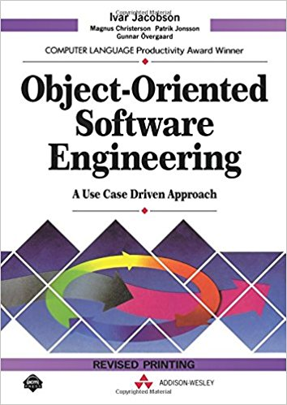
Ivar Jacobson

Slide 24
Use Cases

Slide 25
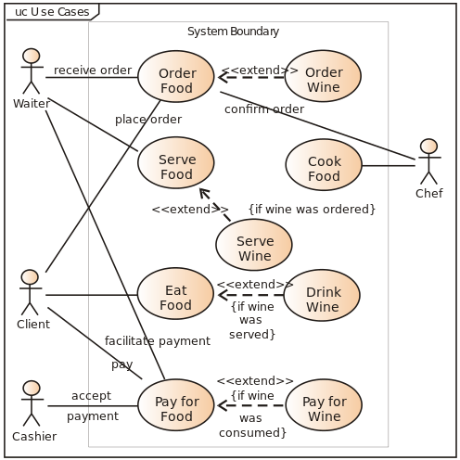
Notes:
In software and systems engineering, a use case is a list of actions or event steps typically defining the interactions between a role (known in the Unified Modeling Language as an actor) and a system to achieve a goal. The actor can be a human or other external system. In systems engineering use cases are used at a higher level than within software engineering often representing missions or stakeholder goals. The detailed requirements may then be captured in the Systems Modeling Language (SysML) or as contractual statements.
Use case analysis is an important and valuable requirement analysis technique that has been widely used in modern software engineering since its formal introduction by Ivar Jacobson in 1992. Use case driven development is a key characteristic of many process models and frameworks such as ICONIX, the Unified Process (UP), the IBM Rational Unified Process (RUP), and the Oracle Unified Method (OUM). With its inherent iterative, incremental and evolutionary nature, use case also fits well for agile development.

Slide 26
Boundary-Controller-Entity
Notes:
Boundary-Controller-Entity is a pattern identified by Ivar Jaobson in his book
Object Oriented Software Engineering: A Use-Case Driven Approach

Slide 27
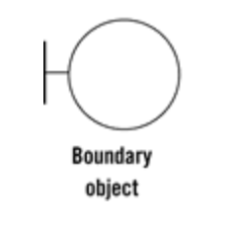
Boundary
The Boundary is an object that interfaces with system actors: user interfaces, gateways, proxies etc.
Notes:
The Boundary is an object that interfaces with system actors: user interfaces, gateways, proxies etc.
Boundary (Interface)
The Boundary objects model the interface with the system.
[…] everything concerning the interface of the system is placed in an interface object
Ivar Jacobson 1992, pp. 134
All functionality dependent on the system environment (tools and delivery mechanisms) belongs in the Boundary objects.
Any interaction of the system with an actor goes through a Boundary object. As Jacobson describes, an actor can be a human user like a customer or an administrator (operator), but it might also be a non-human “user” like an alarm, a printer, or a third party API.

Slide 28
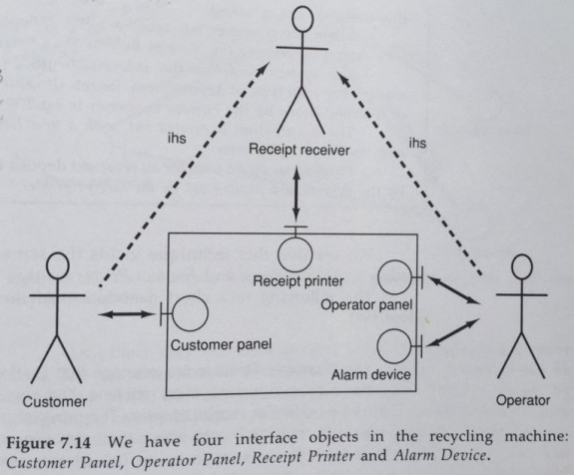
Ivar Jacobson 1992, pp. 171

Slide 29
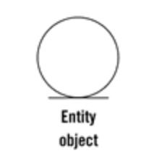
Entity
Entities are objects representing system data: Customer, Transaction, Cart, etc.
Notes:
Entity
The Entity objects hold the data used by the system and all the behavior naturally coupled to this data. Each Entity object represents a concept relevant to the problem domain and which holds identity and resilient (persistent) data. Jacobson tells us that an Entity object should contain the logic that would change when the Entity itself changes, ie. if the data structure it holds changes, the operations on that data will also need to change and therefore they should be located in the Entity as well.
It is interesting to note a warning that Jacobson makes, already back in 1992:
Beginners may sometime only use entity object as data carriers and place all dynamic behavior in control objects […]. This should, however be avoided. […] Instead, quite a lot of behavior should be placed in the entity objects.
They contain application independent business rules i.e. the rules are not dependent on the application it is running in.

Slide 30
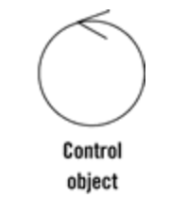
Controller (Interactor)
Controllers are objects that mediate between boundaries and entities. They orchestrate the execution of commands coming from the boundary.
Notes:
Interactor (Control)
The Interactor objects will hold behaviour not naturally tied to any of the other types of objects.
Sutch behaviour consists typically of operations over several Entities, culminating in returning some result to a boundary object.
Behaviour that remains after the Interface objects and Entity objects have obtained their parts will be placed in the control objects
Ivar Jacobson 1992, pp. 185
This means that all behaviour that does not fit into a boundary or Entity will be placed in one or several control objects.
Therefore, Jacobson thinks of Control objects not only as the objects that orchestrate a use case but also as any object that has behaviour relevant for a use case but is not a Boundary nor an Entity.
Comparing with my experience, I would say that he calls interactors to what I call Application Services (who orchestrate use cases) and Domain Services (who contain Domain behaviour but are not entities).
The reason why this intermediary Interactor objects are very important is that if we don’t use them, we will put their specific use case logic in the Entities. However, Entities are used in several use cases and they have, therefore, generic usage. By putting specific use case logic in an Entity, we make it available in several Boundaries, who might end up using it as if it was a generic logic and we might end up changing it to adjust it to another Boundary, increasing its complexity and the chance of breaking the other use cases where it is used.

Slide 31
A use case is a description of the way that an automated system is used. It specifies the input to be provided by the user, the output to be returned to the user, and the processing steps involved in producing that output.
Controllers (Interactors) are objects that implement use cases. There is an interactor for every use case. Name them after the use case. It executes the use case by talking to entities and boundaries. All the interactors together contain your application specific business logic or rules.

Slide 32
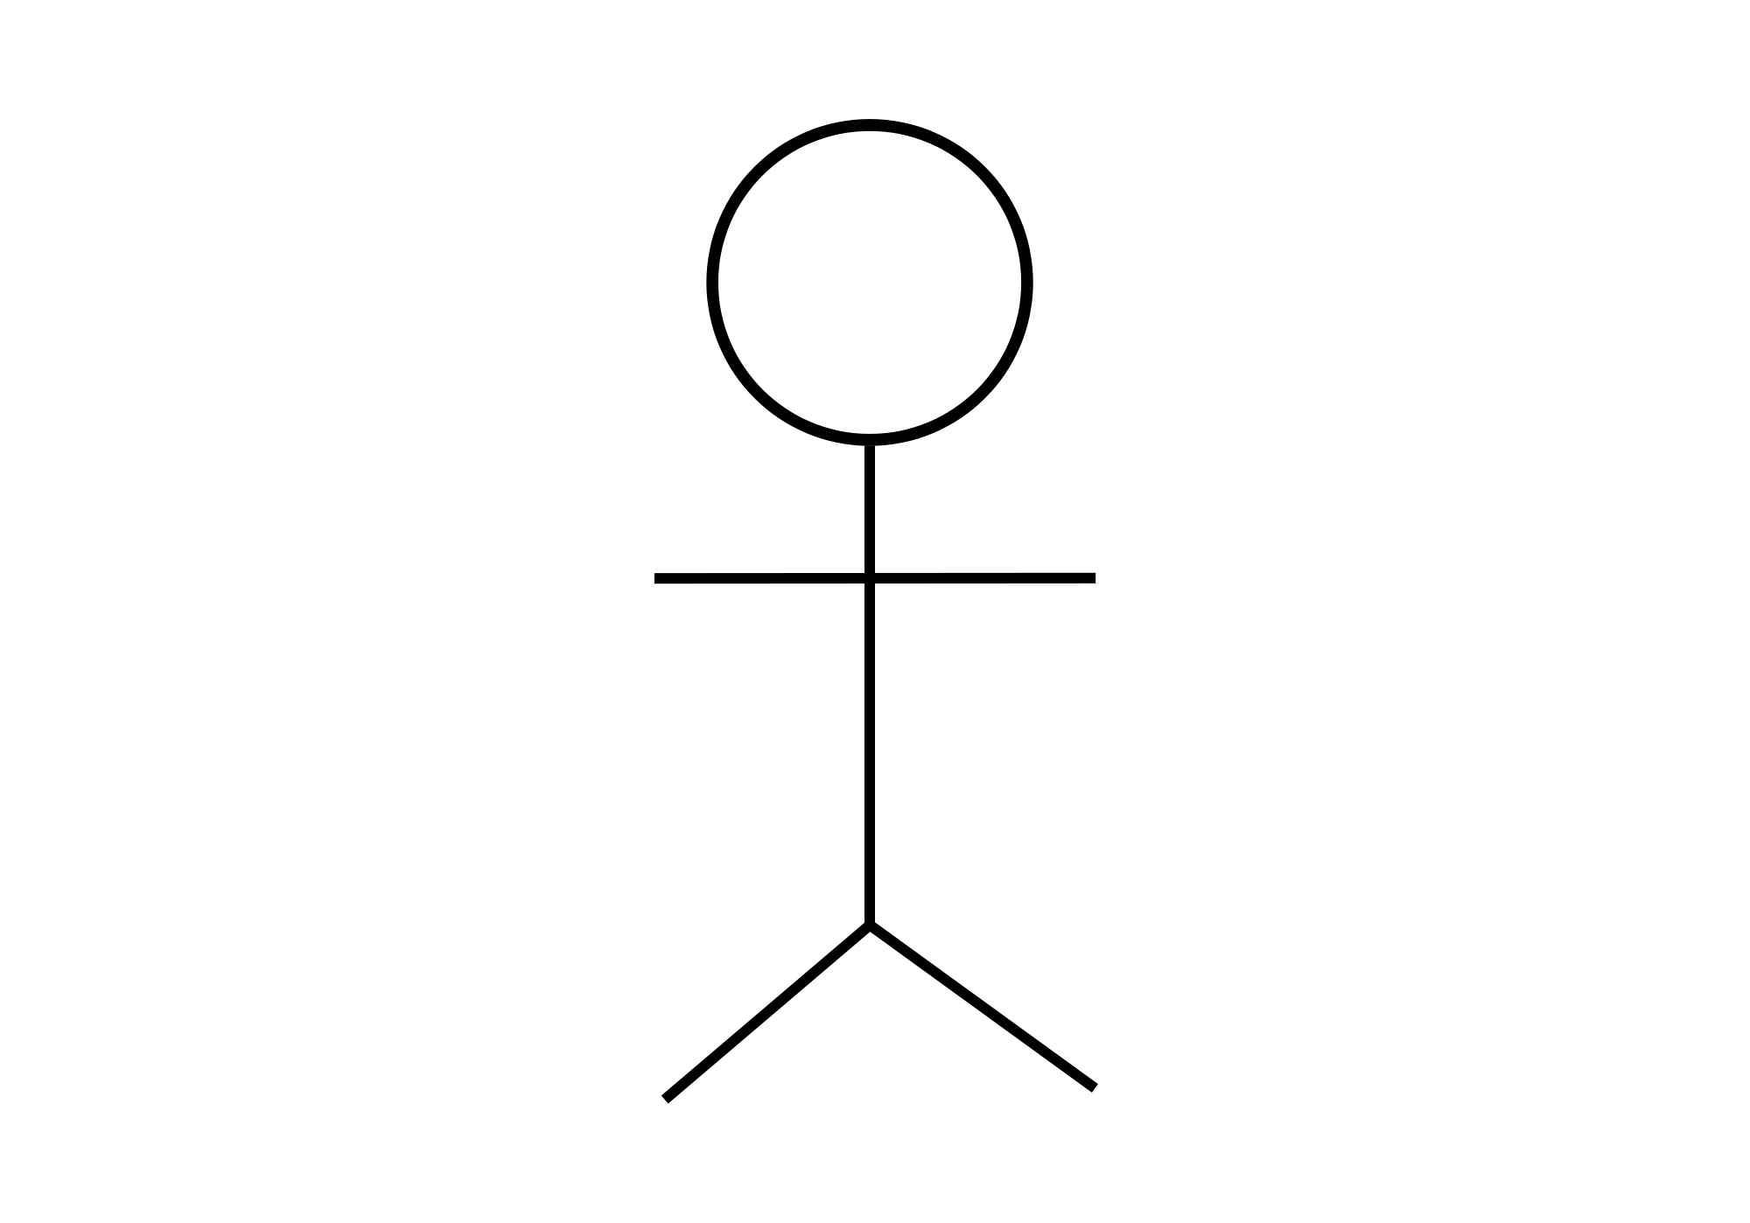

Slide 33
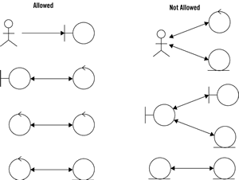
 | Entity | Boundary | Control
Entity |  |  | X
Boundary |  |  | X
Control | X | X | X
Notes:
Both boundary objects and entity objects are nouns, and controllers are verbs. Nouns can't talk to other nouns, but verbs can talk to either nouns or verbs.
Keep in mind that both boundary objects and entity objects are nouns, and that controllers are verbs. Nouns can't talk to other nouns, but verbs can talk to either nouns or verbs. Figure 5 summarizes the robustness diagram rules.
Four rules apply to their communication:
Actors can only talk to boundary objects.
Boundary objects can only talk to controllers and actors.
Entity objects can only talk to controllers.
Controllers can talk to boundary objects and entity objects, and to other controllers, but not to actors

Slide 34
E
Infrastructure
A
Adapter
UI
B
IE
<<interface>>
D
Port
Domain
Application
C

Slide 35
A port is the 'use case boundary'. Use cases become problematic when they become focused on technology concerns. Use cases written against the ports can elide those concerns and focus on the application rules, making them easier to write and maintain.

Slide 37
There is a correlation here between the use case boundary and the test boundary - tests should focus on the behaviour expressed by a use case, not on a unit of code.

Slide 38
Notes:
Unit tests exercise individual objects or value types or small clusters of objects within in a single process. In particular, when doing Test-Driven Development, unit tests exercise code that we can change in response to the feedback we get from writing the tests.
Acceptance tests are customer-facing tests that capture the domain logic the system must perform and demonstrates that it performs them.
The Ports & Adapters architecture makes it possible to run acceptance-tests directly against the application domain model because the domain model is cleanly decoupled from the technical infrastructure that connects it to the outside world. Acceptance tests can interact with the domain model through its port interfaces. Acceptance tests written against an isolated domain model can run extremely fast. Because there is no persistent state involved, in databases or message queues for example, it is easy to isolate tests from one another.
Acceptance tests of a distributed system can instantiate the domain models of different processes in the same memory space and link them by implementations of their port interfaces that do not go out-of-process.

Slide 39
Notes:
The term "integration test" can apply to many different kinds of test. In the book, we use the term specifically to mean the test of an abstraction that we own but have implemented with some third-party package. We want to test that our code implementing the abstraction integrates with that third-party package correctly: that we have not made any incorrect assumptions about how it works or tripped over any bugs that we will have to work around. However, we cannot respond to feedback the tests give us about the internal quality of that third-party package because we cannot change it.

Slide 41
On The Use Case Controller
Vertical Slice Architecture

Slide 42
The Use Case Controller pattern was catalogued in 2001 by Aguiar, Sousa and Pinto
How do you design a system that implements a use-case based approach, in a maintainable fashion?
It needs to preserve the integrity of the use case flow specification and be traceable back to the use case – nowadays we would call this Evident or Screaming Architecture
Callable from different UIs, tests etc.
Open to extension i.e. one use can call another.

Slide 43
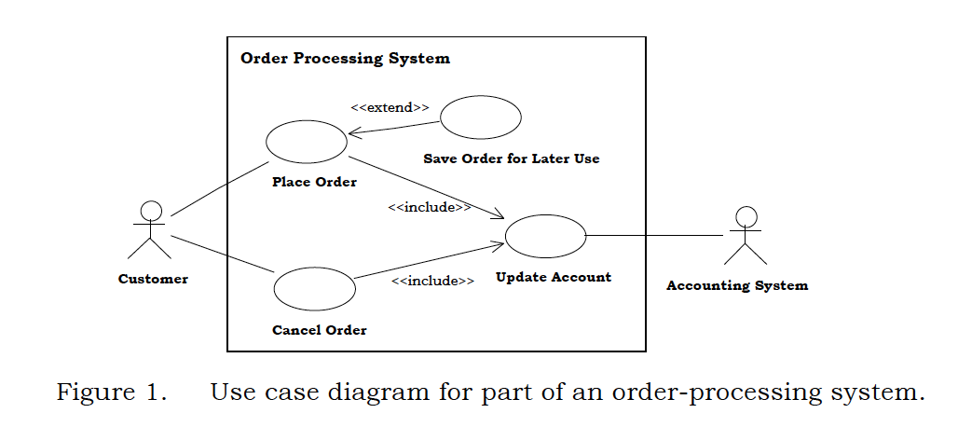
Aguiar, Sousa, Pinto 2001

Slide 44
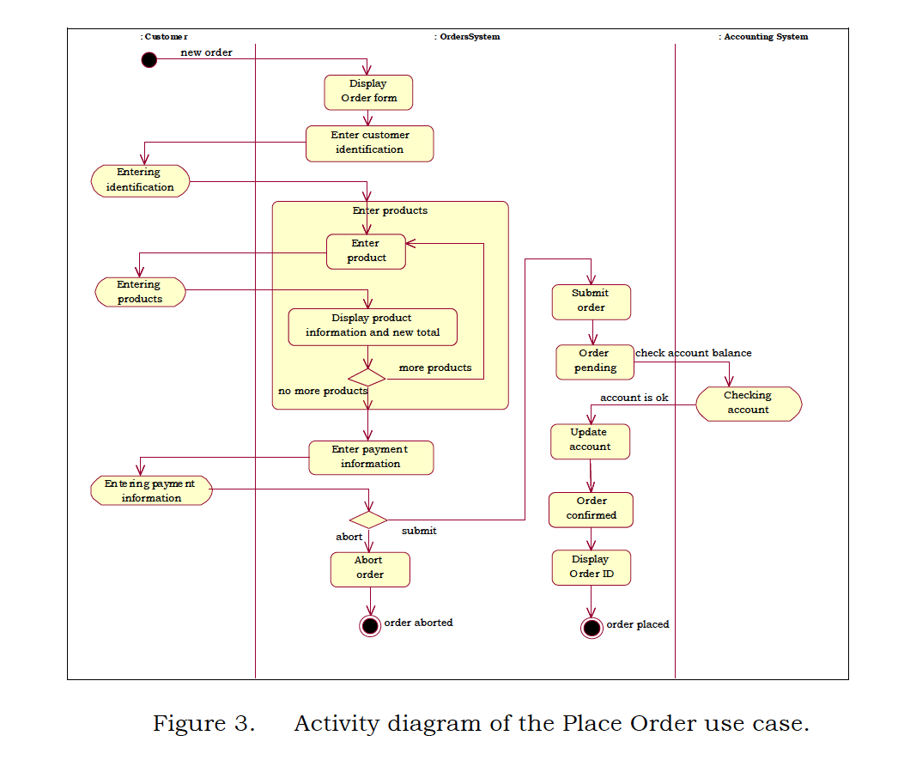
Aguiar, Sousa, Pinto 2001

Slide 45
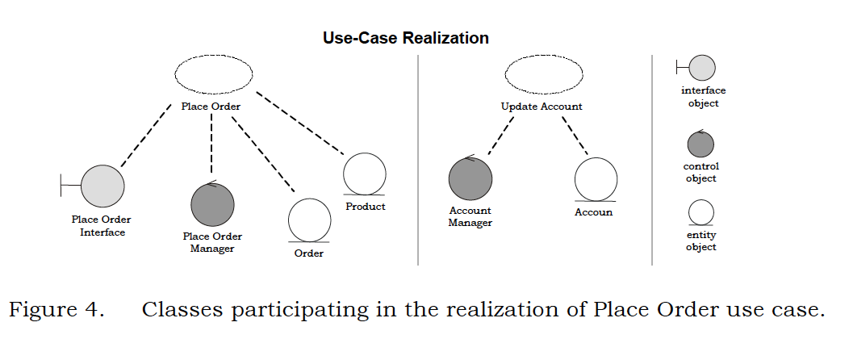
Aguiar, Sousa, Pinto 2001

Slide 46
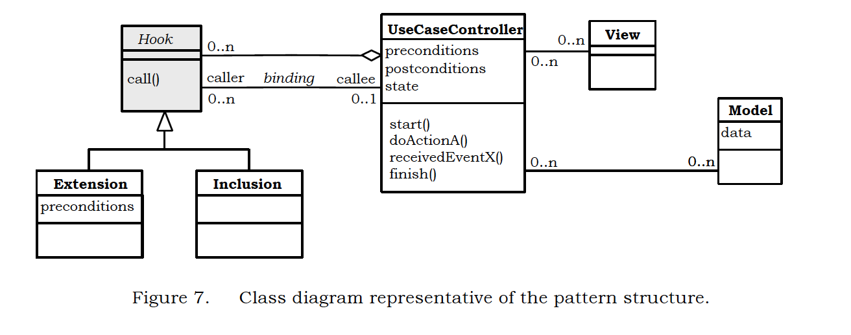
Aguiar, Sousa, Pinto 2001

Slide 47
Identify Candidate Use Cases (user stories are an agile alternative)
For each use case, create a use case controller class
Create the entity and boundary classes needed to implement the use case (boundary should be TDD tests then UI)
Create extension and inclusion hooks for related use-cases
Package use case controllers using a similar organization as the underlying use case model – this is usually within the application logic layer.

Slide 48
Gives localization of business rules and policies
Easy replacement of user interface and system components
Visibility of use cases within the implementation code
Flexible configuration using plug-in or extension model

Slide 49
Aguiar, Sousa and Pinto note that the controller may be implemented using Command and the Command Processor pattern.
They also note that the controller may be a Chain of Responsibility (for orthogonal concerns)

Slide 50
On Clean Architecture

Slide 51
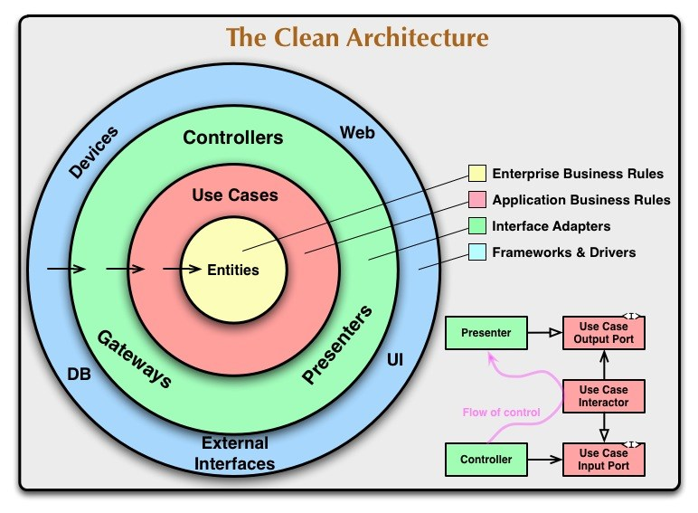
Notes:
The concentric circles represent different areas of software. In general, the further in you go, the higher level the software becomes. The outer circles are mechanisms. The inner circles are policies.
The overriding rule that makes this architecture work is The Dependency Rule. This rule says that source code dependencies can only point inwards. Nothing in an inner circle can know anything at all about something in an outer circle. In particular, the name of something declared in an outer circle must not be mentioned by the code in an inner circle. That includes, functions, classes. variables, or any other named software entity.
By the same token, data formats used in an outer circle should not be used by an inner circle, especially if those formats are generate by a framework in an outer circle. We don’t want anything in an outer circle to impact the inner circles.
Entities
Entities encapsulate Enterprise wide business rules. An entity can be an object with methods, or it can be a set of data structures and functions. It doesn’t matter so long as the entities could be used by many different applications in the enterprise.
Use Cases
The software in this layer contains application specific business rules. It encapsulates and implements all of the use cases of the system. These use cases orchestrate the flow of data to and from the entities, and direct those entities to use their enterprise wide business rules to achieve the goals of the use case
Interface Adapters
The software in this layer is a set of adapters that convert data from the format most convenient for the use cases and entities, to the format most convenient for some external agency such as the Database or the Web. It is this layer, for example, that will wholly contain the MVC architecture of a GUI. The Presenters, Views, and Controllers all belong in here. The models are likely just data structures that are passed from the controllers to the use cases, and then back from the use cases to the presenters and views.
Frameworks and Drivers.
The outermost layer is generally composed of frameworks and tools such as the Database, the Web Framework, etc. Generally you don’t write much code in this layer other than glue code that communicates to the next circle inwards.

Slide 52
Request Model
Entity
Entity
Interactor
<<interface>>
Entity
Delivery Mechanism
Boundary
Entity
Use Cases
Response Model
Entity Gateway
<<interface>>
Data Structure
Frameworks & Drivers
Interface Adapters
Notes:
The Request Model is a pure data structure, it has no behavior. It comes through the boundary and it reaches the Interactor, that is named not Interactor, but for the use case. The Interactor goes and finds the Entities, calls the appropriate methods, and then gathers the Response Model from the data.
It sounds like HTTP Request-Response, but there is no HTTP.
To Test: Create the Interactor, Create The Request Model, Run the Interactor and check the Response Model.
You have no dependency on the delivery mechanism. In fact the delivery mechanism depends on you, the application controller, which is your plugin into the framework and implements an interface

Slide 53
Request Model
Entity
Entity
Interactor
<<interface>>
Entity
API Framework
Web Controller
Entity
Use Cases
Presenter
<<interface>>
Response Model
Response Model
Entity Gateway
<<interface>>
Data Structure
Frameworks & Drivers
ViewModel
<<interface>>
Interface Adapters
View
Notes:
A user talks to a delivery mechanism, in this case an API. Eventually a controller gets invoked, with a request model that it then passes to the interactor. The interactor then loads the entities, exercises their business rules, invoked its own business rules, and collates the result into a response model which it passes back, via the web controller to the API framework which serializes it out the user
Note that the Web Controller is a Presenter, and it works with a View Model, that it turns into a view.

Slide 54
Request Model
Entity
Entity
Interactor
<<interface>>
Entity
API
Framework
Web Controller
Entity
Use Cases
Response Model
Entity Gateway
<<interface>>
Data Structure
Frameworks & Drivers
Delivery Mechanism
Interface Adapters
DB
Notes:
How do we talk to the Db. We implement the interface with a concrete boundary component that talks to the DB

Slide 55
On Implementing
Port, Boundary, Interactor, call it what you will but how do we do it?

Slide 56
Demo

Slide 57
Service Facade
public class MyFatService
{
public void CreateMyThing(/* .. parameters ...*/)
{
/*Stuff*/
}
public void UpdateMyThingForFoo(/* .. parameters ...*/)
{
/*Other Stuff*/
}
public void UpdateMyThingForBar(/* .. parameters ...*/)
{
/*Other Stuff*/
}
/*Loads more of these*/
}
A Facade used in this context is being used in the Service role, where the Service stereotype describes an object that provides co-ordination and control logic. It provides a contract to clients for lower layers.
Notes:
One question is, how is our API provided? We are inside an adapter, so we want to use a Plain Old C# Object (POCO) approach to avoid framework dependencies. A common route is to use the Facade pattern, providing a class that holds the API to lower level components. Indeed this is the classical implementation strategy for the application service layer in an layered architecture. The Facade design pattern provides a high-level interface to a sub-system, shielding the caller from the implementation details of the sub-system. This both reduces complexity for the caller, and decouples the caller from the implementation allowing us to vary it without amending the caller. To this extent it meets the needs of our port, providing a clear notion of outside - the caller and inside - the subsystem.

Slide 58
Interface Segregation Principle
public interface ICreateMyThingService
{
void CreateMyThing(/* .. parameters ...*/);
}
public interface IUpdateMyThingForFooService
{
void UpdateMyThingForFoo(/* .. parameters ...*/);
}
public class MyFatService : ICreateMyThingService, IUpdateMyThingForFooService,
{
public void CreateMyThing(/* .. parameters ...*/)
{
/*Stuff*/
}
}
Notes:
The Interface Segregation Principle states that clients should not be forced to depend on methods on an interface that they do not use. This is because we do not want to update the client because the interface changes to service other clients in a way that the client itself does not care about. A Transaction Script style port forces consumers (for example MVC controllers) to become dependent on methods on the domain service class that they do not consume.
Now this can be obviated by having the domain service implement a number of interfaces, and hand to its clients interfaces that only cover the concerns they have. With application service layers this naturally tends towards one method per interface.

Slide 59
Single Responsibility Principle
public interface ICreateMyThingService
{
void CreateMyThing(/* .. parameters ...*/);
}
public class CreateMyThingService : ICreateMyThingService
{
public void CreateMyThing(/* .. parameters ...*/)
{
/*Stuff */
}
}
public interface IUpdateMyThingForFooService
{
void UpdateMyThingForFoo(/* .. parameters ...*/);
}
public class UpdateMyThingForFooService : IUpdateMyThingForBarService
{
public void UpdateMyThingForBar(/* .. parameters ...*/)
{
/*Other Stuff*/
}
}
Notes:
Now the Single Responsibility Principle suggests that a class should have one and only one reason to change. All these separate interfaces begin to suggest that a separate class might be better for each interface, to avoid updating a class for concerns that it does not have. So we tend to move toward one class per API endpoint.

Slide 60
Demo

Slide 61
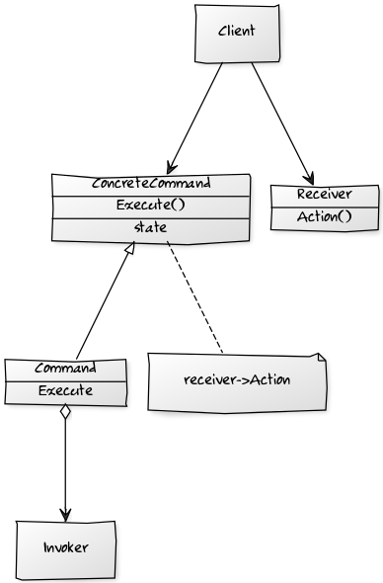
Command Design Pattern
Command - Declares an interface for executing an operation.
ConcreteCommand –Defines a binding between a Receiver object and an action. Implements Execute by invoking the corresponding operation(s) on Receiver.
Client – creates a ConcreteCommand object and sets its receiver.
Invoker - asks the command to carry out the request.
Notes:
The command design pattern encapsulates a request as an object, allowing reuse, queuing or logging of requests, or undoable operations.
It also serves to decouple the implementation of the request from the requestor. The caller of a command object does not need to understand how the command is actioned, only that the command exists. When the caller and the implementer are decoupled it becomes easy to replace or refactor the implementation of the request, without impacting the caller - our system is more modifiable. Our ability to test the command in isolation of the caller - allows us to implement the ports and adapters model easily - we can instantiate the command, provide 'fake' parameters to it and confirm the results. We can also use the command from multiple callers, although this is not a differentiator from the service class approach.

Slide 62
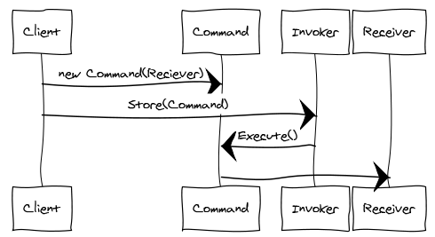
An Invoker object knows about the concrete Command object.
The Invoker issues a request by calling Execute on the Command.
When commands are un-doable, the Command stores state for undoing the command prior to invoking Execute.
The Command object invokes operations on its Receiver to carry out the request
Notes:
In addition we can structure a system transaction ally using commands.
A command is essentially a transactional boundary.
Because a command is a transactional boundary, when using the Domain Driven Development technique of an aggregate there is a natural affinity between the command, which operates on a transactional boundary and the aggregate which is a transactional boundary within the domain model.
The aggregate is the Receiver stereotype within the Command Design pattern.
Because we want to separate use of outgoing adapters via a secondary port, such as a Repository in the DDD case, this can lead to a pattern for implementation of a command:
1: Begin Transaction
2: Load from Repository
3: Operate on Aggregate
4: Flush to Repository
5: Commit Transaction
In the Repository pattern we may need to notify other aggregates that can be eventually consistent of the change within the transaction ally consistent boundary. The pattern suggested there is a notification. Because the handling of that notification is in itself likely to be a transactional boundary for a different aggregate we can encapsulate this domain event with the Command design pattern as well, which gives rise to the following additional step to the sequence, outside the original transactional boundary:
6: Invoke Command Encapsulating Notification
Note that this is, in essence, the actor model.

Slide 63
Implementing a Command
Fpublic interface IAmACommand
{
void Execute();
}
public class UpdateMyThingForFooFooCommand
{
public UpdateMyThingForFooCommand(/* .. parameters ...*/)
{
/* Initialize state of command for members */
}
public void Execute()
{
/*Other Stuff*/
}
}
Notes:
Implementing the pattern is simple, we implement a command interface, that has a method to execute the command. We then create a concrete instance of the command that derives from this interface. The invoking class executes the command without being directly coupled to the receiver which the command uses to implement the action requested.

Slide 64
Request Model
Command
Entity
Entity
ICommand
<<interface>>
Entity
Delivery Mechanism
Boundary
Entity
Use Cases
Response Model
Entity Gateway
<<interface>>
Data Structure
Frameworks & Drivers
Interface Adapters
Notes:
The Request Model is a pure data structure, it has no behavior. It comes through the boundary and it reaches the Interactor, that is named not Interactor, but for the use case. The Interactor goes and finds the Entities, calls the appropriate methods, and then gathers the Response Model from the data.
It sounds like HTTP Request-Response, but there is no HTTP.
To Test: Create the Interactor, Create The Request Model, Run the Interactor and check the Response Model.
You have no dependency on the delivery mechanism. In fact the delivery mechanism depends on you, the application controller, which is your plugin into the framework and implements an interface

Slide 65
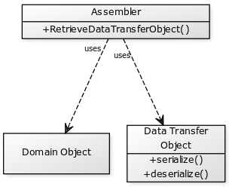
Assembler- Turns domain objects into a Data Transfer Object.
Data Transfer Object–A data structure, often a Value Object, used to hold data returned by our façade. Where we have one DTO tailored for an adapter to return to a client, that may span multiple domain objects we may use the term View Model.
Domain Object- the domain object(s) we query the state of.
Notes:
If the command represents our update to the state of the domain, what do we do with those parts of our interface that represent a query.
Remember that the Command-Query Separation Principle tells us to favour a side-affect free interface. A command updates state and a query retrieves state.
We tend to use the same approach as before, an interface with a single method, and have that method return a DTO that is the representing the state to be returned.
We often call this DTO a View Model because it will maps one to one to what the adapter returns and the single method interface a View Model Retriever for that reason, although the DTO pattern Assembler would be just as accurate.
This is not yet, but in essence this moves us toward Command-Query Responsibility Separation (CQRS) which is another set of constraints on components in the layered architecture style.

Slide 66
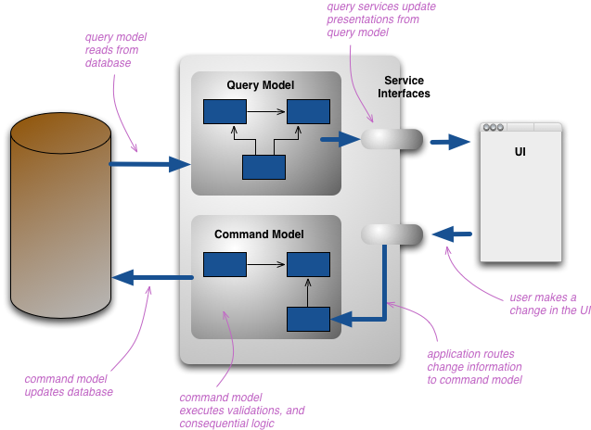
Command Query Separation
Components are either query-side components or command-side components.
The path of a request through the system only passes through command-side or query-side components depending on whether it is querying or modifying the state of the system.
Only command-side components can update a repository, query-side components just read from it.
Commands and queries are usually explicit components on their respective sides.
Both the command-side and the query-side are layered, but there are usually far fewer layers on the query-side.
Commonly the command-side components are a domain model, though other styles such as procedural are not forbidden.
The query-side components might be elevated to a domain model, but are normally just procedural.
Martin Fowler, http://martinfowler.com/bliki/CQRS.html

Slide 67
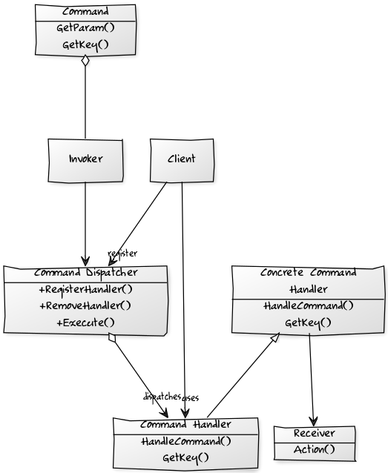
Command Dispatcher
Invoker - has a lit of Commands that are to be executed
Command - represents the request to be processed, encapsulating the parameters to be passed to the command-handler to perform the request
Command Handler - specifies the interface that any command handler must implement
Concrete Command Handler – implements the request
Command Dispatcher – Allows dynamic registration of Command Handlers and looks up handlers for commands, by matching command and handler key.
Client – registers Commands with the Command Dispatcher.
Notes:
To decouple a higher and lower layers we want to be able alter the implementation of the commands that we call on the lower layer without altering the calling layer.
We introduce a Command Handler for each Command that can be invoked, that all implement a specific interface. Command-handlers are registered with a Command Dispatcher (and can also be removed) at run-time.
When the application issues a command, it notifies the Command Dispatcher which dispatches to the command handler(s) associated with the command.
This decouples dispatch from processing.
The Command Dispatcher allows dynamic registration and removal of Command Handlers, it is an administrative entity that manages linking of commands to the appropriate command handlers.
It relates to the Observer pattern in that hooks together publishers and subscribers.
Command Dispatcher registration requires a key – provided by the Command Dispatcher for the Commands it can service, using getKey(). [In practice we often use RTTI for this].
The Command Handler is fired, when a command with the same name (key) is sent to the Command Dispatcher.
The Command Dispatcher is a repository of key-value pairs (key., Command Handler) and when the Command Dispatcher is called it looks up the command’s key in the repository. If there is a match it calls the appropriate method(s) on the handler to process the Command.

Slide 68
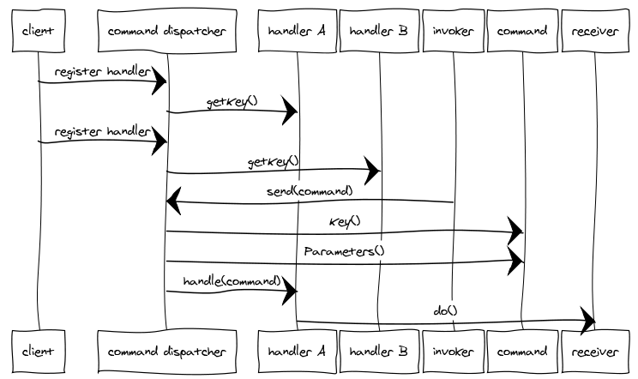
Notes:
We want to separate an Action-Request object that contains the identity of the action we want to perform, and the parameter for that action from the Action-Handler which knows how to perform that action.
A Command Dispatcher is an object that links the Action-Request with the appropriate Action-Handler.
We may distinguish between a Command Action-Request that has one Action Handler and an Event Action-Request that has many

Slide 69
Demo

Slide 70
